Slide 1
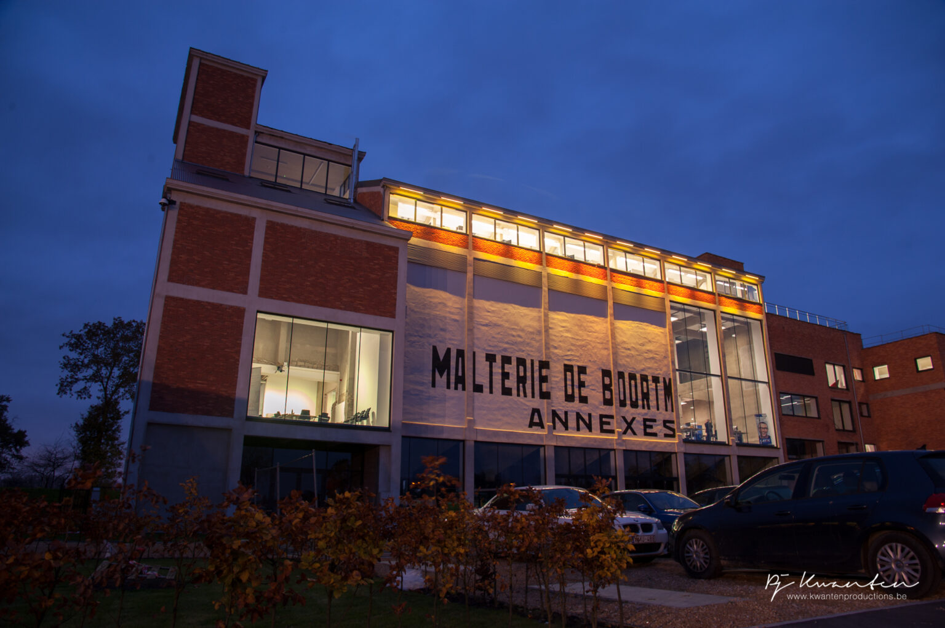
Learning driver preferences
ORTEC Belgium
Tim
Hellemans

Slide 2
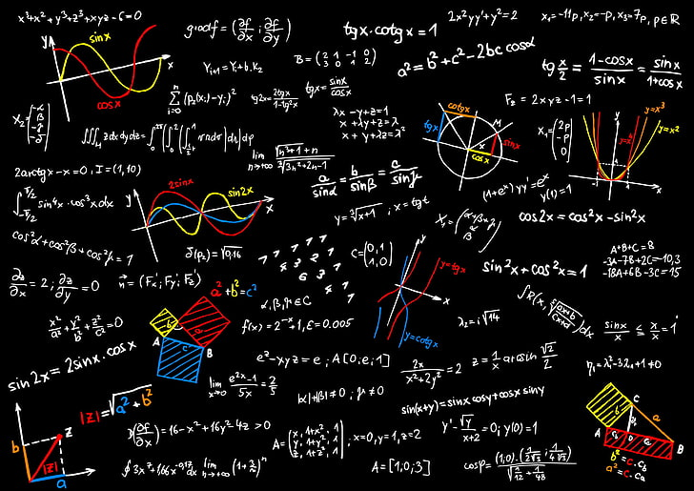
Outline
01
Agenda & overall goal
02
Optimization Engine
03
Learning preferences

Slide 3

Agenda & overall goal

Slide 4
Request
Cloud
OR Algorithm
Goal: Improve the overall process by learning from historic communication between users & the OR algorithm.
Response
Business
Technical
Understand the overall process.
Think about deploying a potential solution.
Define a clear scope at the start of the project.
Manage your project & time effectively in order to ensure maximal results at the end of day 2.
Create an appealing story.
Have effective communication with the client to understand what does (not) work
Understand & preprocess a complex database.
Understand the problem & set up an effective environment to tackle it.
Develop (multiple) models & improve their performance through:
Feature selection & engineering.
Model selection & tuning.
Conceptually think about methods to model more complex problems.
Explain models in their business context using visualizations.
End goal:
Create a short business presentation; show the potential value of what you worked on.
Create a more in depth presentation on the thought process/performance/methodology behind the models. Make sure your explanation is in the business context

Slide 5
Agenda
Day 1
09:00 - 09:45 | Problem introduction by Tim Hellemans.
09:45 - 10:30 | Creating a plan of action/dividing tasks.
13:00 - 13:30 | Lunch meeting with business, first findings & questions.
16:00 - 17:00 | Time to reflect (group conversation on team dynamics)
17:00 – 18:00 | Work & decide on which pizza to order
18:00-… | Pizza! & Work until tired
Day 2
09:00-09:15 | Small update for Tim, make plan for today
13:00 – 13:30 | Lunch meeting, status, most technical stuff should be done at this point.
16:00 – 17:00 | Final presentation, questions & feedback. Presentation needs to start high level with some clear key takeaways; but can go more in depth on the modelling challenges afterwards.
17:00 – 18:00 | Reception

Slide 6

Optimization engine

Slide 7
Optimization Complexity
Vehicles
Start Location
Visit Locations
A
B
C

Slide 8
Optimization Complexity
60 Solutions
2
3
1
1
3
2
2
3
1
1
3
2
1
3
1
2
2
3
3
2
2
1
3
1
1
3
1
2
2
3
3
2
2
1
3
1
2
3
1
1
3
2
2
2
1
1
1
3
1
2
2
3
3
2
2
1
3
1
1
1
1
2
1
2
2
2
1
1
2
2
2
2
1
1
2
2
2
1
2
1
1
1
1
1
1
2
1
2
2
2
1
1
2
2
2
2
1
1
2
2
2
1
2
1
1
1
1
1
1
2
1
2
2
2
1
1
2
2
2
2
2
1
2
1
1
1

Slide 9
Optimization Complexity
Vehicles | Locations | Formula | Solutions
3 | 3 | 3 x 4 x 5 | 60
3 | 6 | 3 x 4 x 5 x 6 x 7 x 8 | 20,160
3 | 9 | 3 x 4 x 5 x 6 x 7 x 8 x 9 x 10 x 11 | 19,958,400
5 | 25 | 5 x 6 x 7 x 8 x 9 x 10 x 11 x 12 x 13 x 14 x 15 x 16 x 17 x 18 x 19 x 20 x 21 x 22 x 23 x 24 x 25 x 26 x 27 x 28 x 29 | 368,406,749,739,154,000,000,000,000,000 = 368 x 10²⁷
m | n | m x (m + 1) x … x (m + n - 1)
For 5 vehicles and 25 locations → more than 10 trillion years calculation time

Slide 10
Optimization Complexity
Exact Methods
Small problem instances
Examine all solutions
Approximation Methods
Small to large problem instances
Optimization strategy modeled based on data, business rules, and objectives
Heuristics
Metaheuristics

Slide 11
Solution Approach
Construction
Strategy based on data, business rules, objectives, and planning processes
Local Search
Heuristics that locally search for improvements of the objectives: cost, distance, hours
Large Neighborhood Search
Metaheuristics that search on a local and global scale for improvements: Ruin and Recreate
Build Routes
Local Improvements
Global Improvements

Slide 12
Phase 1 · Build Routes
Taking into account the business rules
Route #1
1
2
3
12
11
D
4
10
8
6
5
9
7
Route #3
Route #2
Unplanned Stops
Build Route #1
Build Route #2 and #3

Slide 13
Phase 2 · Local Improvements
Multiple improvements methods
Repeated multiple times
Within Routes
Between Routes

Slide 14
Phase 2 · Local Improvements
Move
Swap
Start Situation
Move Stop
Swap Stops

Slide 15
Phase 3 · Global Improvements
Optimize by making global changes
Cost
local minimum
local minimum
Solution Space

Slide 16
Phase 3 · Global Improvements
Ruin and Recreate
Solution
Choose whether to accept the new found solution
Choose a ruin method to remove a part of the solution
Acceptance
Ruin
Choose whether to try to improve the new found solution
Local Search
Recreate
Choose a recreate method to find a new solution

Slide 17
Phase 3 · Global Improvements
Ruin and Recreate
Random Select Stops
Start Situation
Remove Stops
Re-insert Stops

Slide 18
Adaptive Large Neighborhood Search
Filters out
‘bad methods’
Easy to
implement
Roulette Wheel
Adaptive
Diversification
Can handle
many
problems

Slide 19
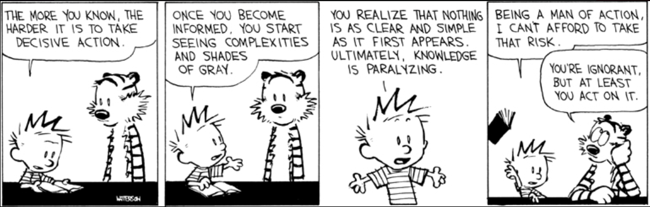
Learning preferences

Slide 20
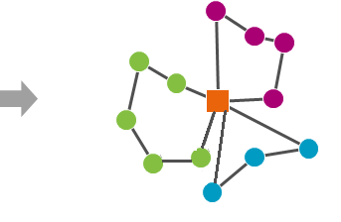
Problem setting
Move
Start Situation
Optimal solution
Used solution

Slide 21
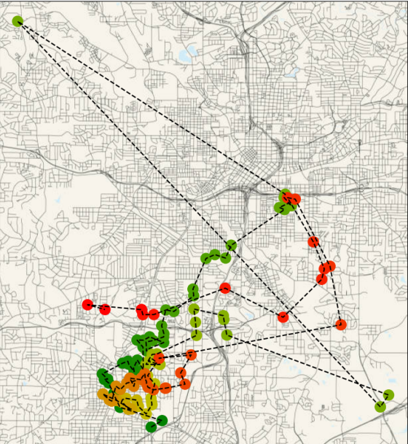
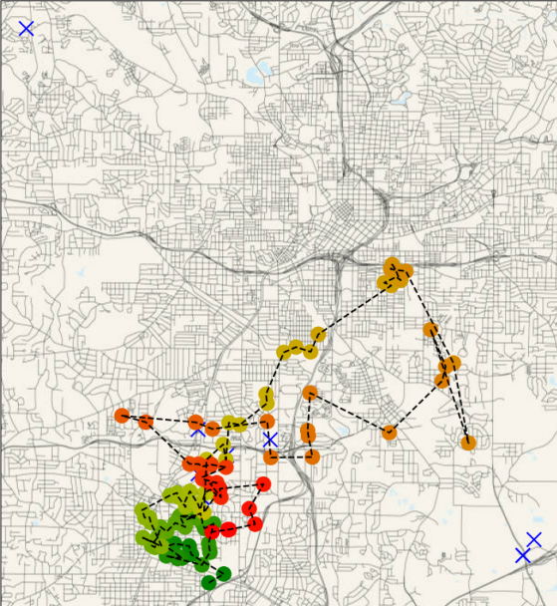
Problem setting

Slide 22
Sub-problems
Removing locations
A driver decides to remove certain locations from his route
Adding locations
We need to add these locations to some other route
Reordering route
Use an alternative order of the locations on a route.

Slide 23











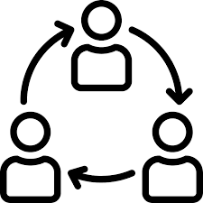
Further than cost saving: the human factor
FACT
Drivers are a scarce and precious resource
Drivers have knowledge and experience that is difficult to capture in “mathematics”
Drivers are frustrated with plans that don’t “feel logical” to their way of working
Implicit feedback: log and monitor differences between planned vs actual (package swap)
Explicit feedback: give drivers the chance to rate stops and routes
Our current focus
capture driver’s knowledge, experience and preferences
FEEDBACK
Thinking in terms of sequential steps will not allow us to tap in the human factor
Thinking in of continuous improvement allows to directly feed the feedback into tactical and operational plans

Slide 24
Do drivers actually find a better theoretical solution?
In general: no, not really.
Specific example:
Remark: Although the routes look worse on paper, there can still be a lot of value in the driver’s choices!
Cost optimized route | Cost driver | Difference
1065.615 | 1150.218 | 7.94%
634.564 | 652.097 | 2.76%
1015.78 | 1051.991 | 3.56%
1000.486 | 1021.003 | 2.05%
1007.807 | 1043.514 | 3.54%

Slide 25

Goal and deliverables
Analyse successive optimization calls from the same driver
Derive patterns, such as:
Stops that are forced to be delivered in one cluster
Precedence relations between stops/areas
Determine how these patterns can be (machine) learned
Determine how these patterns can be fed back into the parcel route optimizer
Main deliverable: advise on how to learn patterns from successive optimization runs and use that in the optimizer

Slide 26
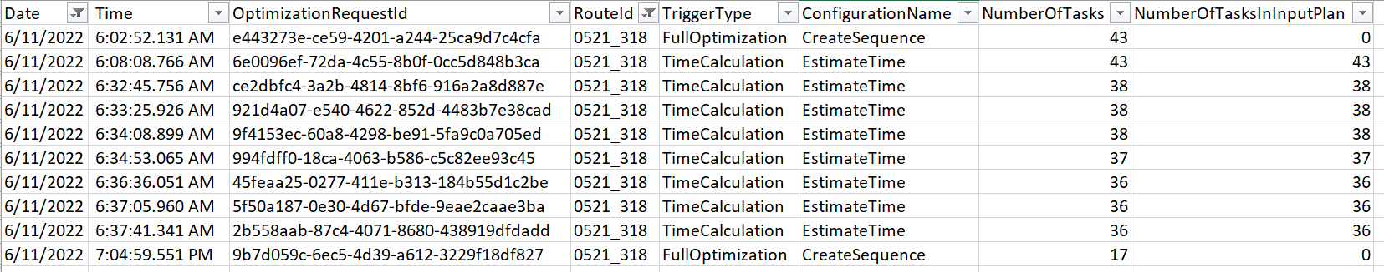
What does an optimization cycle look like?
Single day, only morning, single route
Compare the request last request with the first response

Slide 27


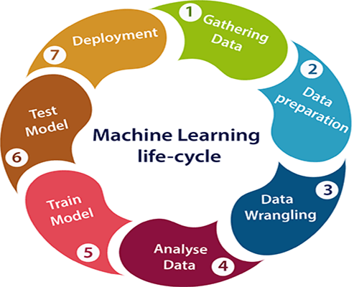

Machine learning life cycle

